Slide 1
FLIGHT PRICE PREDICTION PROJECT PRESENTATION
Submitted by:
PRATIK KUMAR (Data Science Intern at Flip Robo Technologies)

Slide 2
PROBLEM STATEMENT
The airline industry is considered as one of the most sophisticated industry in using complex pricing strategies. Nowadays, ticket prices can vary dynamically and significantly for the same flight, even for nearby seats. Anyone who has booked a flight ticket knows how unexpectedly the prices vary. The cheapest available ticket on a given flight gets more and less expensive over time. This usually happens as an attempt to maximize revenue based on
1. Time of purchase patterns (making sure last-minute purchases are expensive)
2. Keeping the flight as full as they want it (raising prices on a flight which is filling up in order to reduce sales and hold back inventory for those expensive last-minute expensive purchases)

Slide 3
PHASES OF THE PROJECT
This project is done in three parts:
- Data Collection
- Data Analysis
- Model Building
I created two different Jupyter Notebook files to performed the required actions.
As per the requirement of client, I have scrapped the data from online sites and based on that data I have performed analysis like based on which feature of my data does flight prices change and checked the relationship of flight prices with all the other features to get a gist on what flight a passenger should choose.

Slide 4

MODEL BUILDING STEPS
1. Data Cleaning
2. Exploratory Data Analysis
3. Data Pre-processing
4. Model Building
5. Model Evaluation
6. Selecting the best model

Slide 5
WEB SCRAPING WEBPAGES FOR FLIGHTS

Slide 6
EXPLORATORY DATA ANALYSIS (EDA)
First I have imported the necessary libraries and loaded the entire dataset in our Jupyter Notebook and renamed the project file from untitled.
Then I checked the shape of our dataset and found that we have a total of 5,805 rows and 9 different columns.
We don’t have any null values or missing values present in our dataset from the web scraping.
There were 232 duplicate rows/records in our dataset but I decided to retain them instead of deleting it.
By checking the data types I came to know that our data set consists of columns having only object datatype even those there were numeric information present.
Shape : 5,805 rows and 9 columns
No null values present
232 duplicate rows/records were found
Datatype of only object columns are in dataset

Slide 7
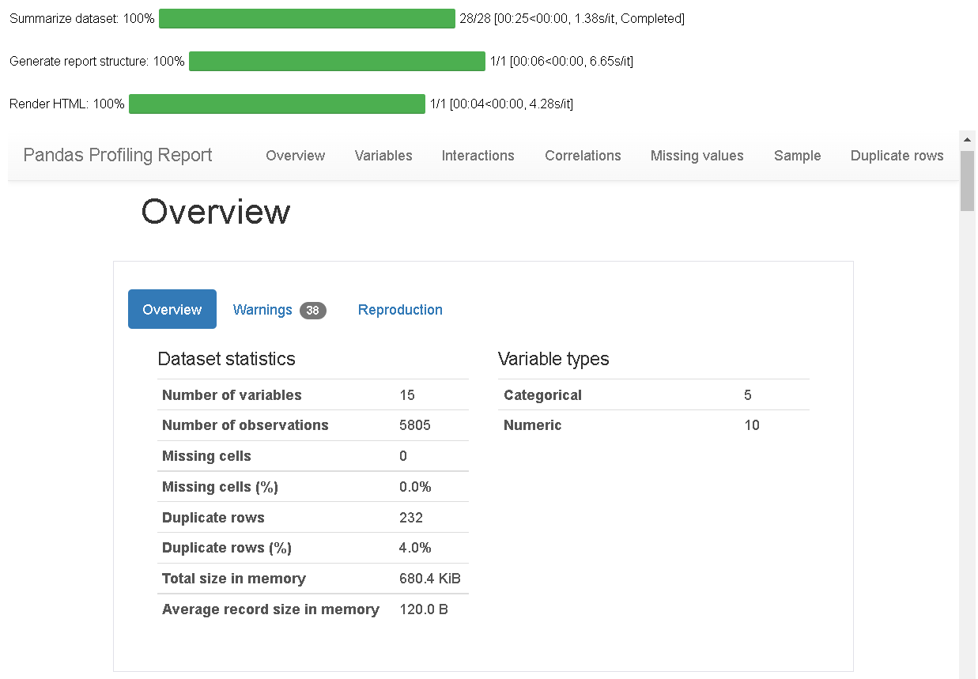
VISUALIZATION USING PANDAS PROFILING REPORT
Here I have made use of pandas profiling to get a gist of my pre processed data and get a insight on the basic overview of my dataset values.

Slide 8
COUNT PLOTS

Slide 9
BAR PLOTS

Slide 10
BAR PLOTS AND SCATTER PLOTS

Slide 11
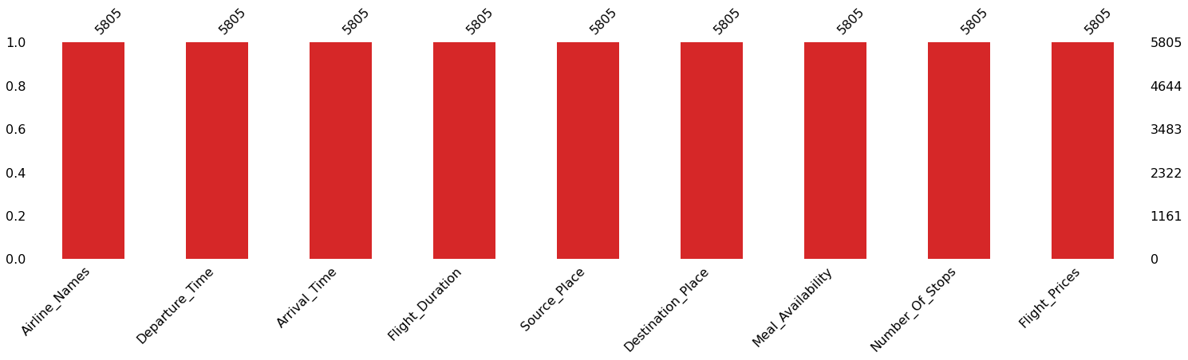
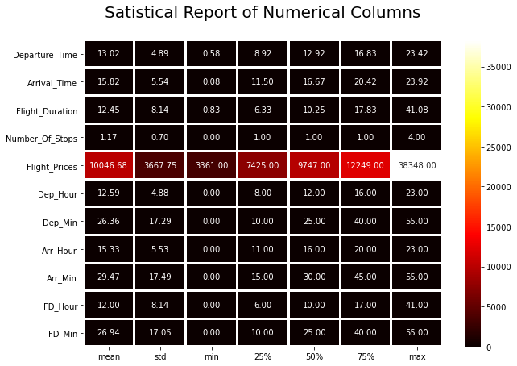
MISSING VALUES AND DESCRIBE DATA

Slide 12
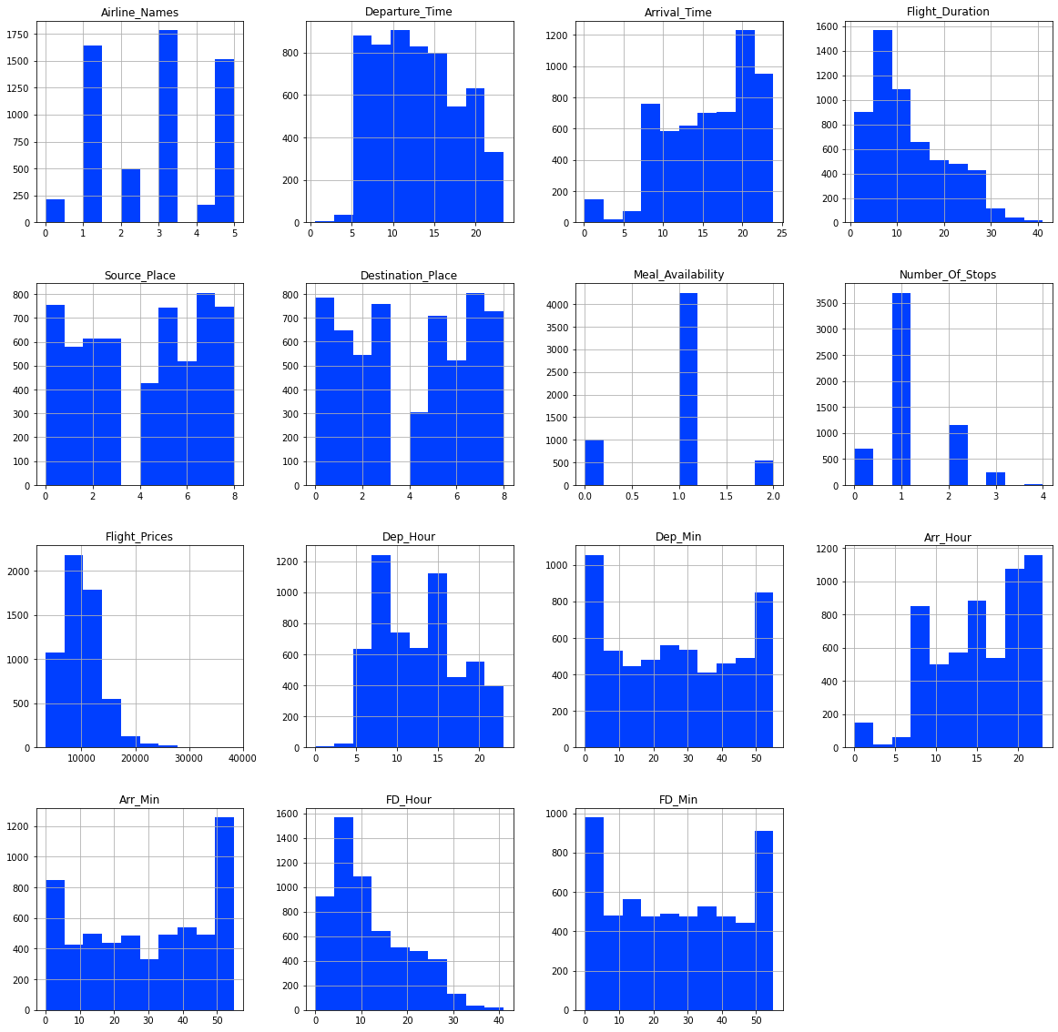
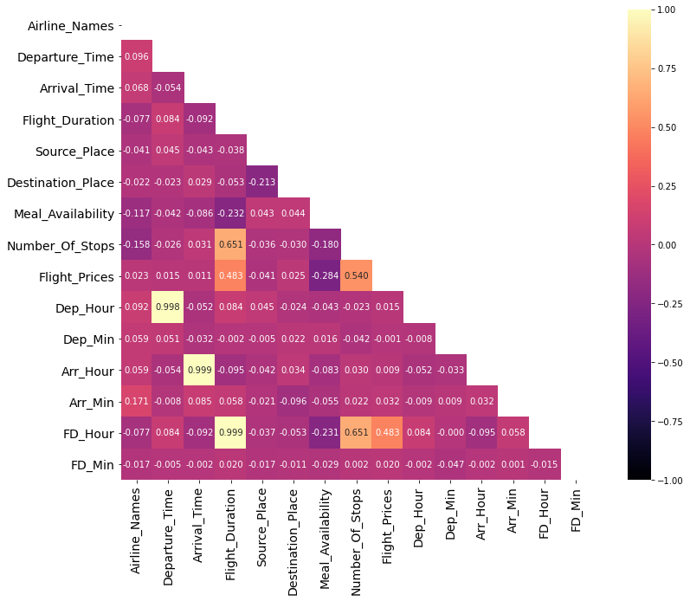
HISTOGRAM AND HEATMAP

Slide 13
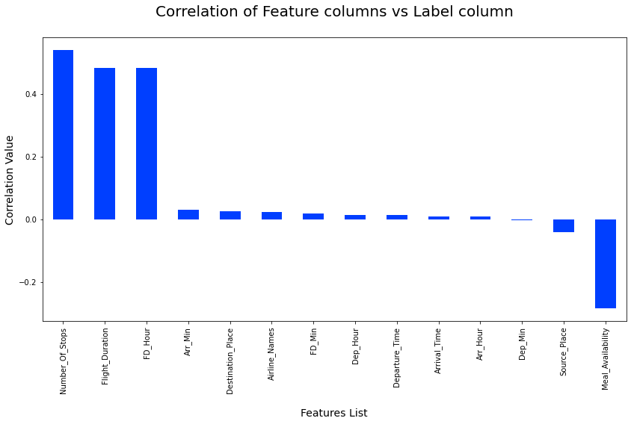
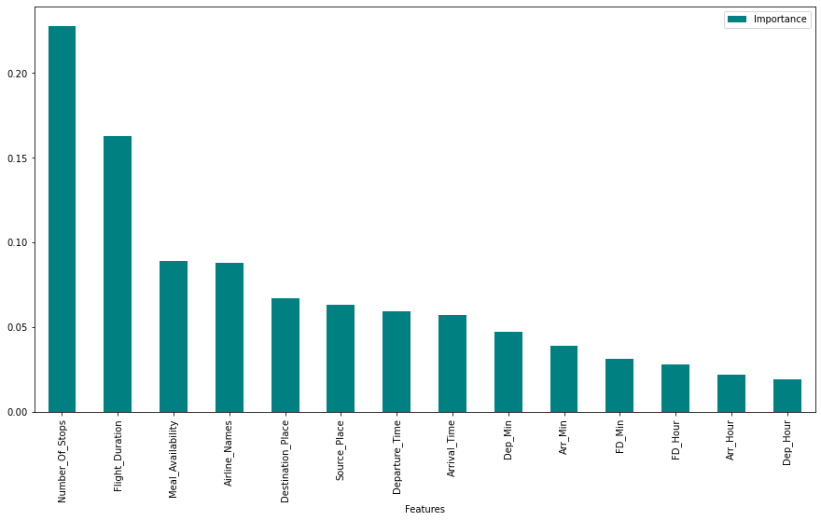
CORRELATION AND IMPORTANCE BAR GRAPHS

Slide 14
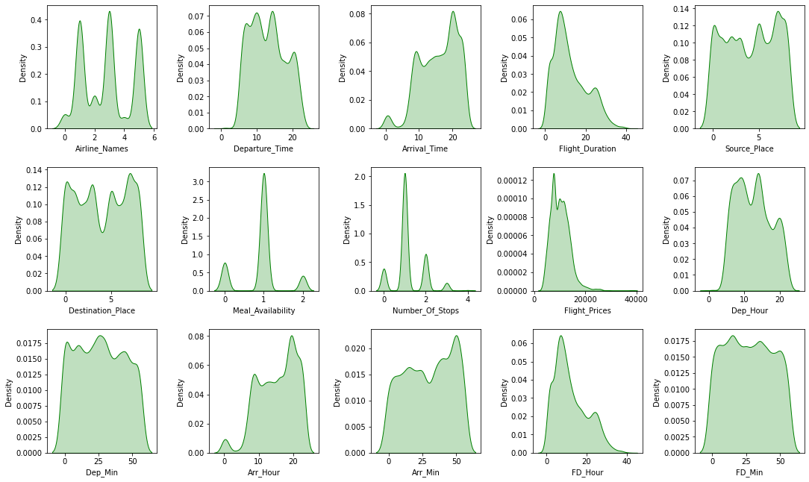
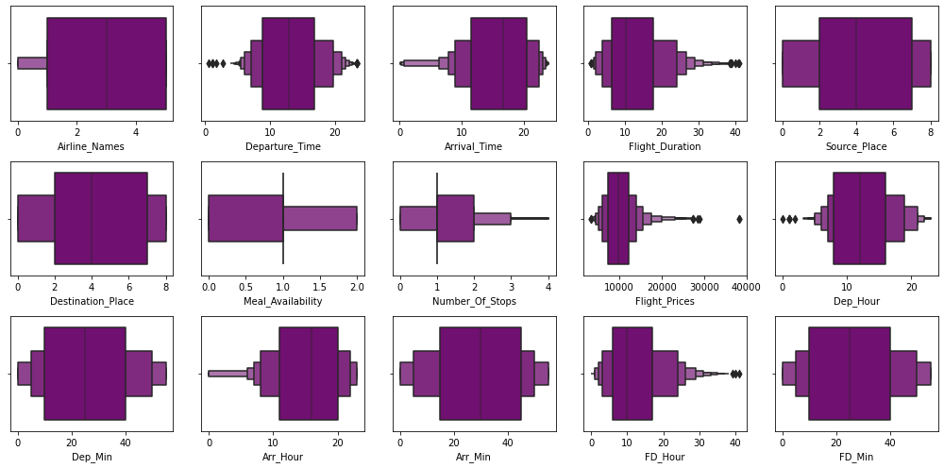
OUTLIERS AND SKEWNESS

Slide 15
RESULT OF MULTIPLE REGRESSION MODELS

